Slide 1


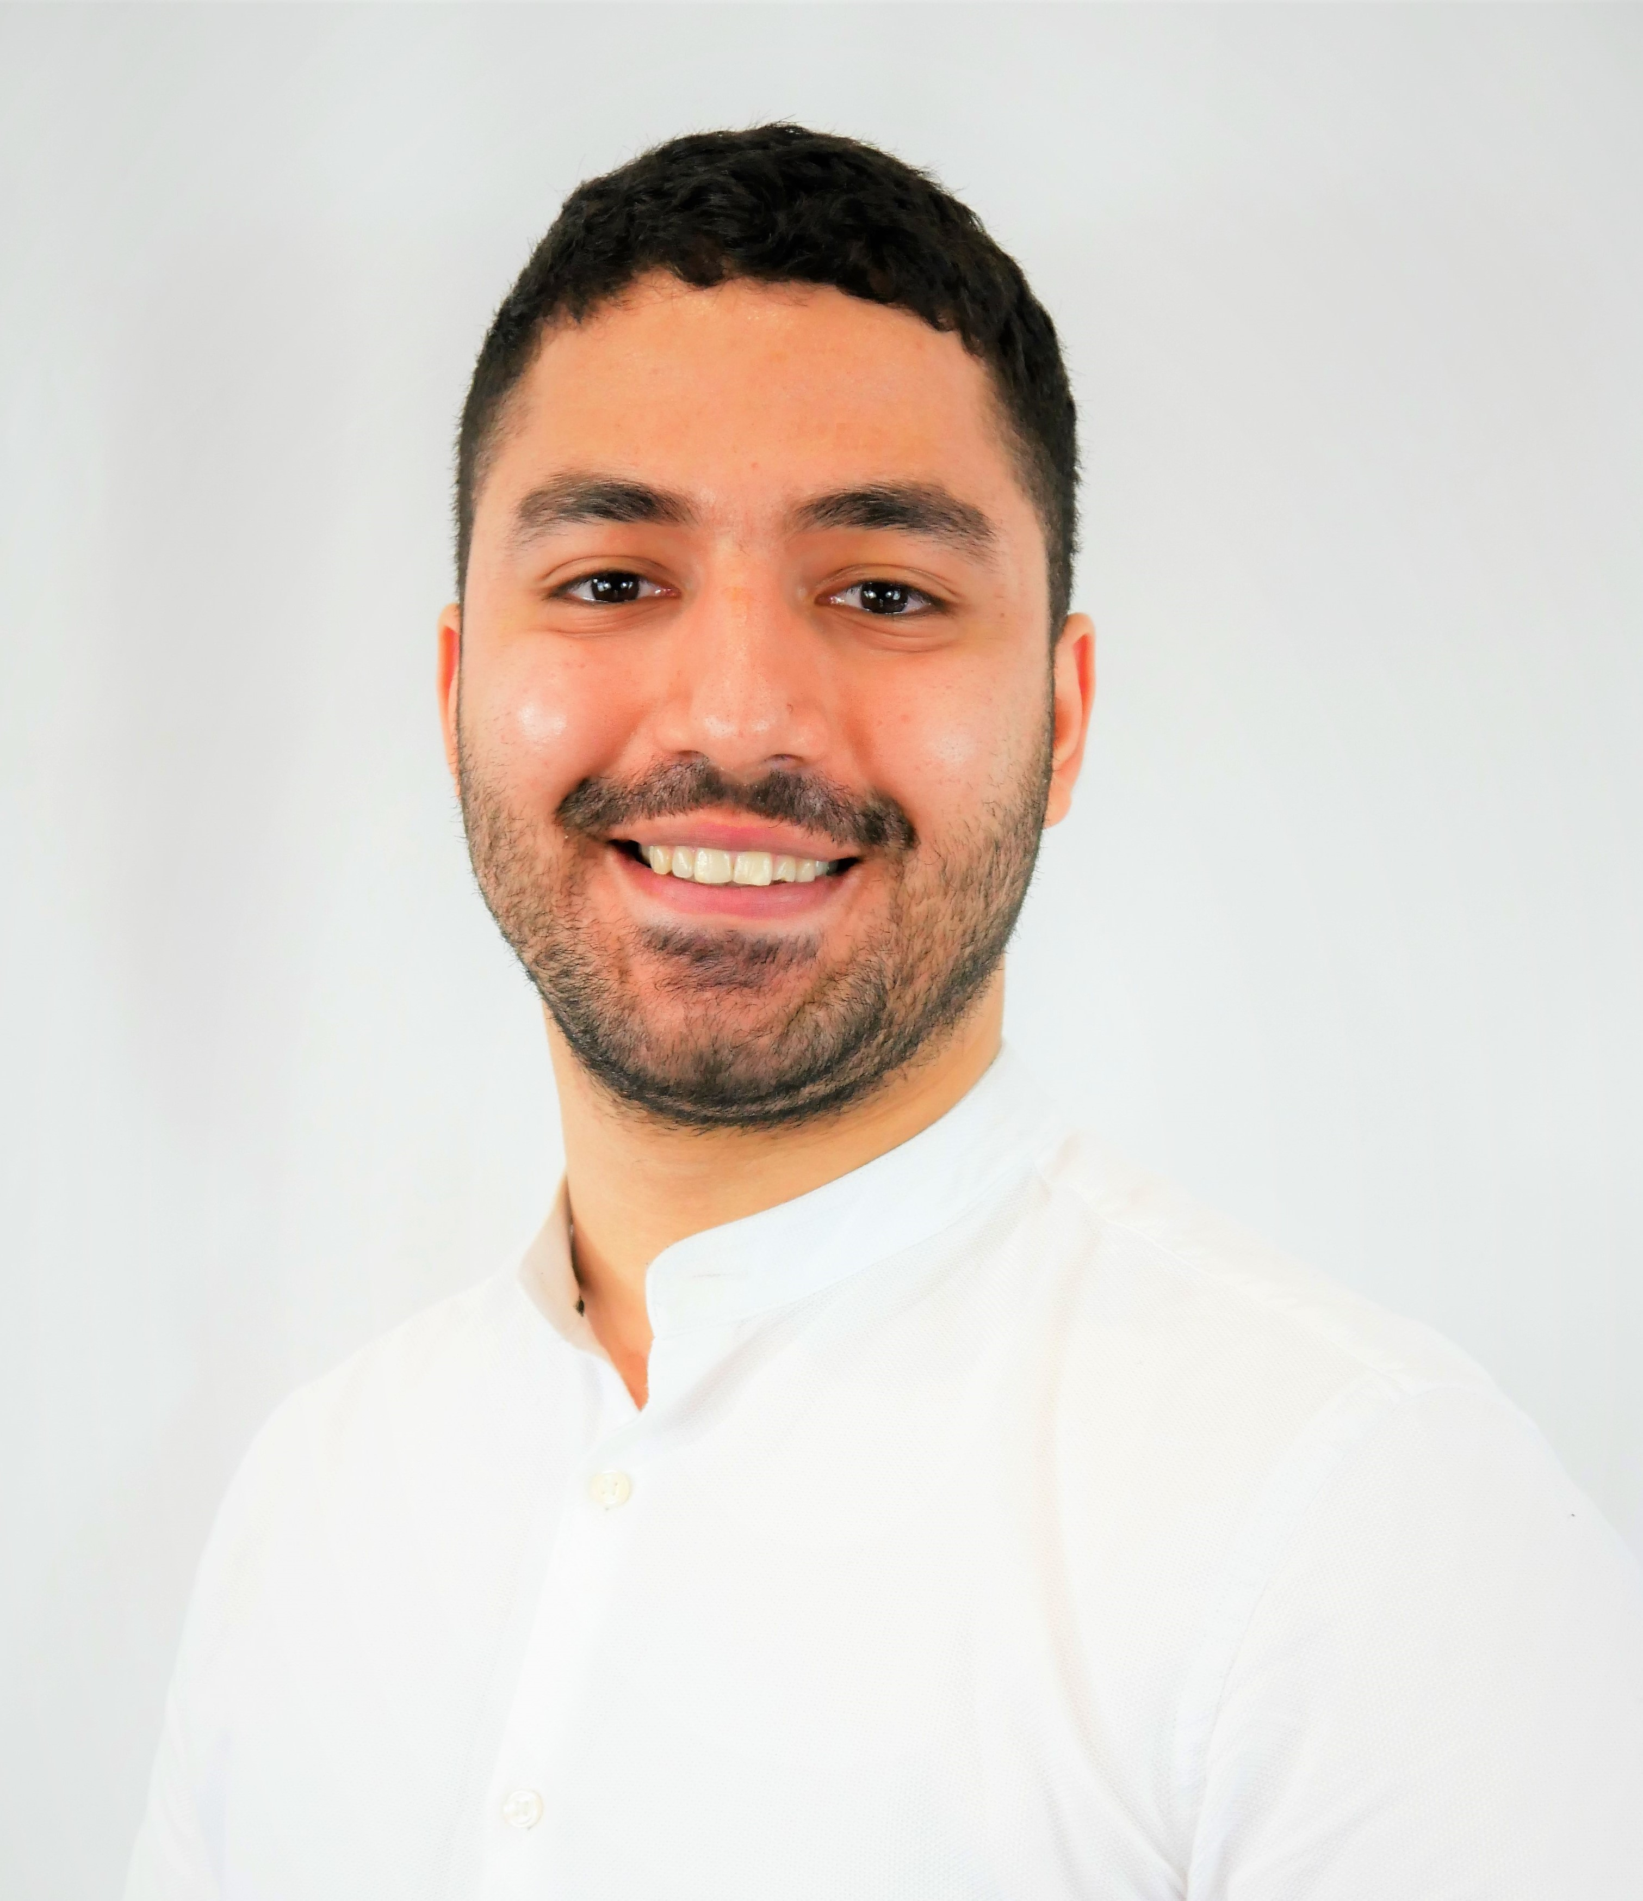
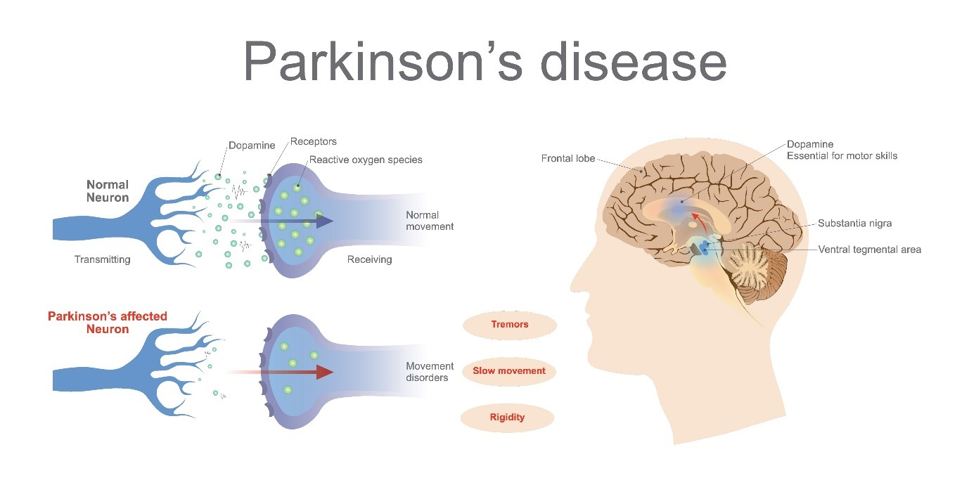
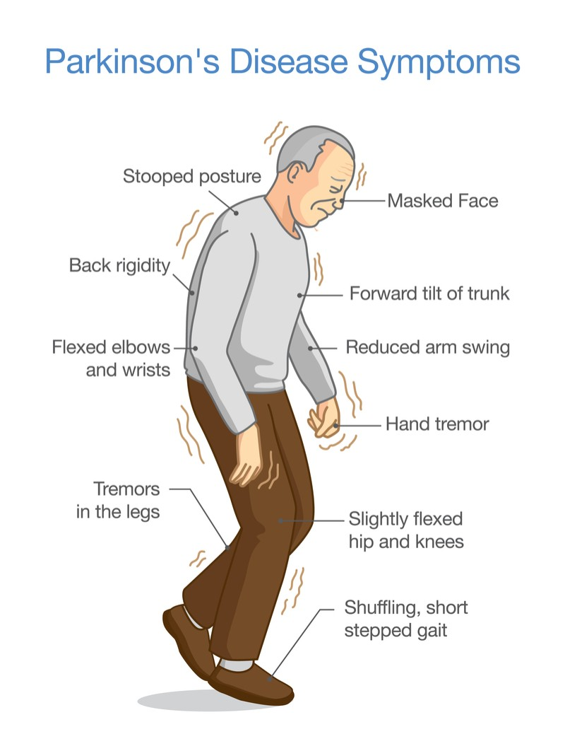
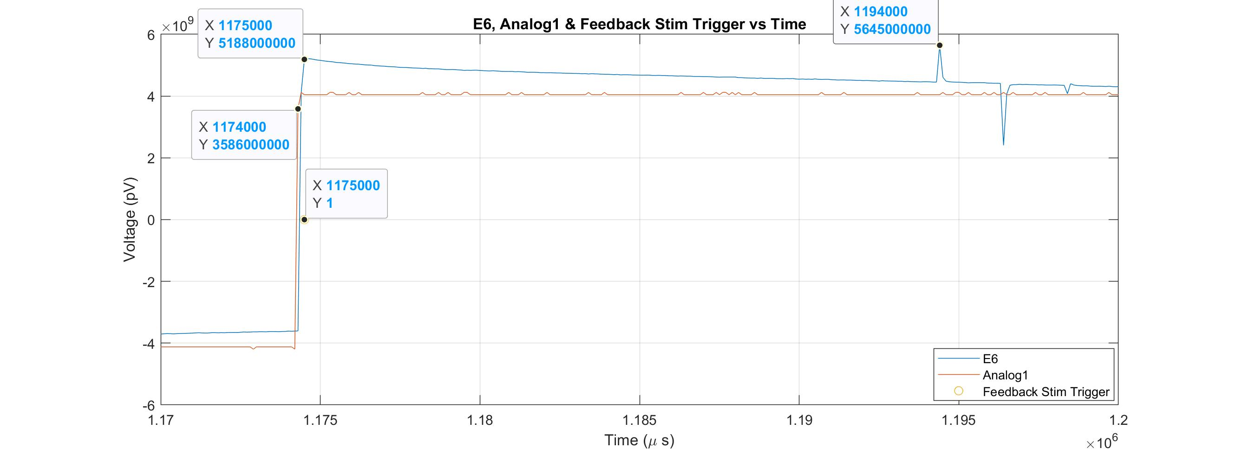
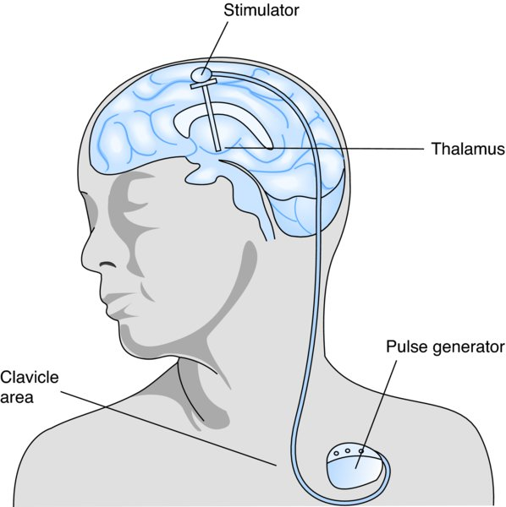
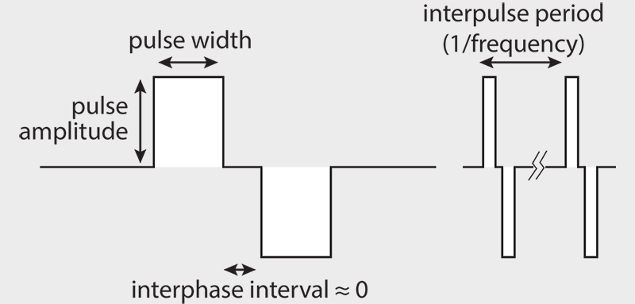
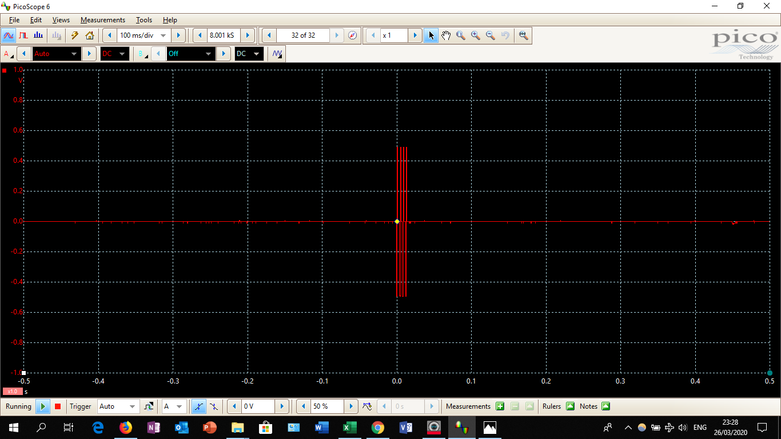

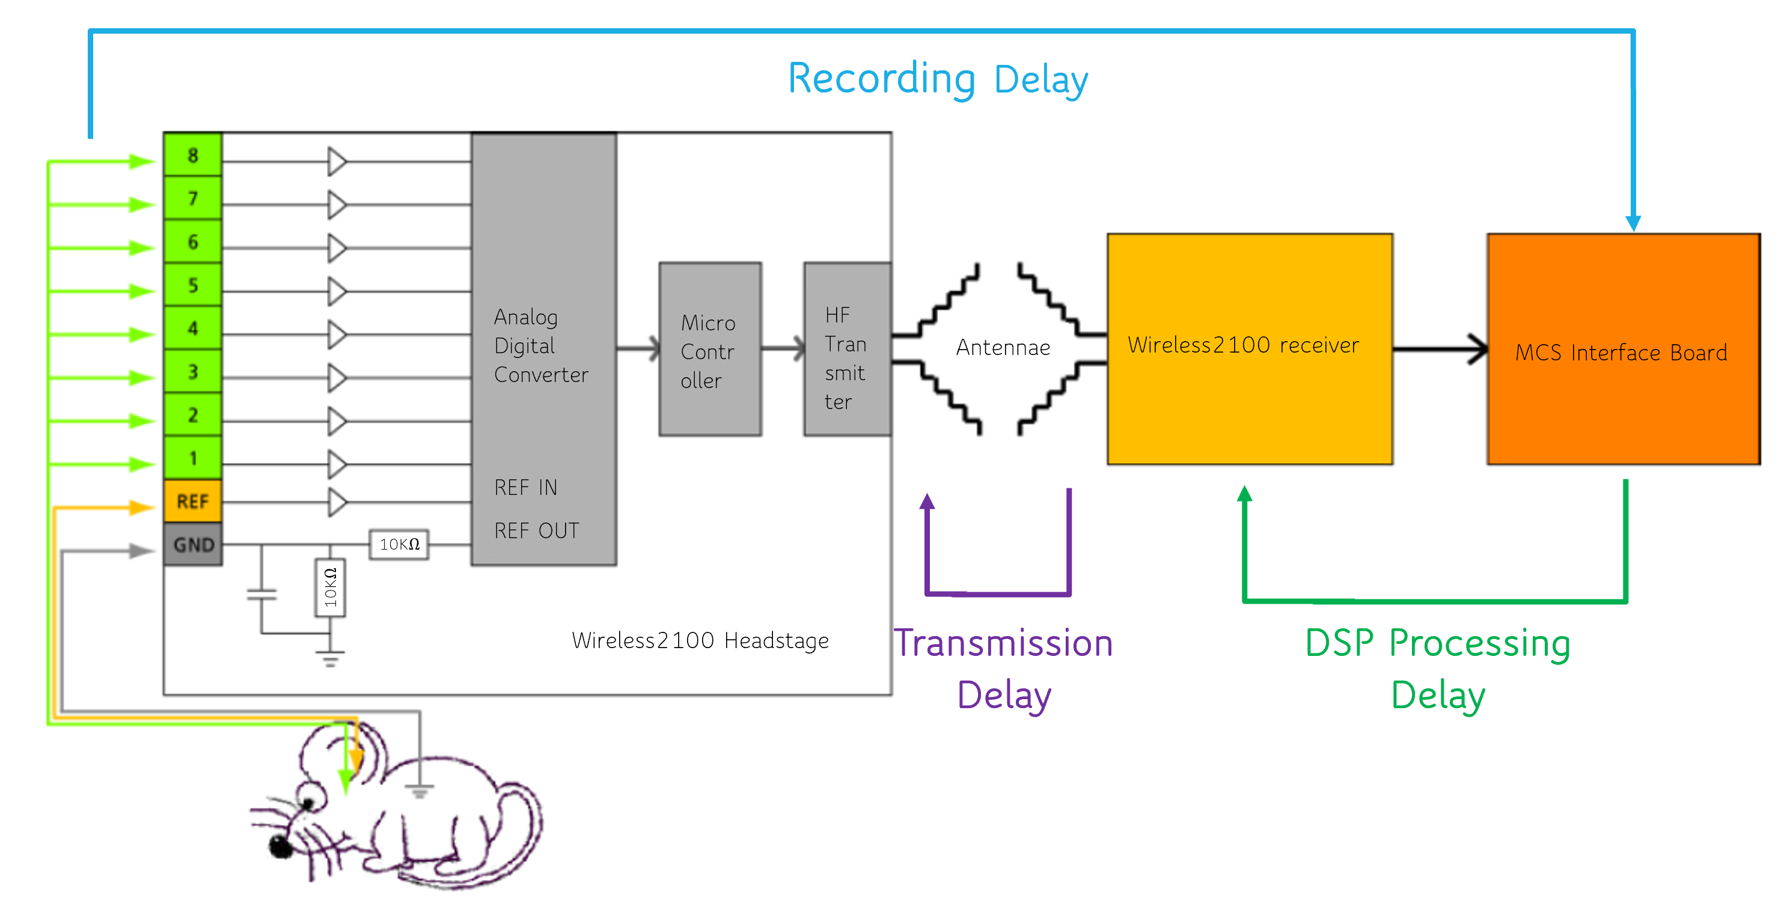
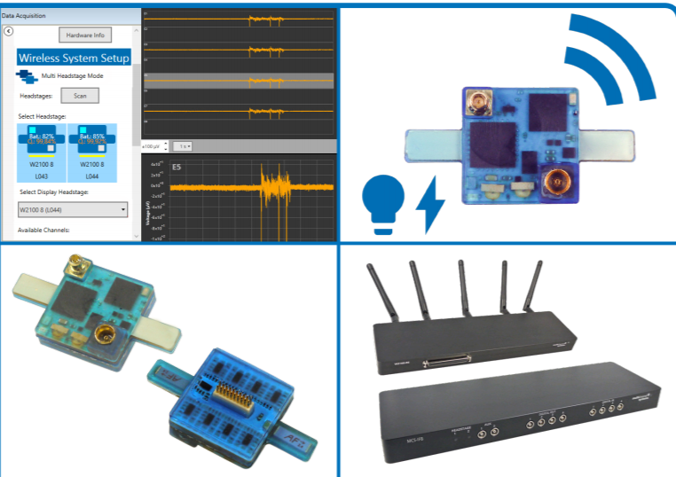
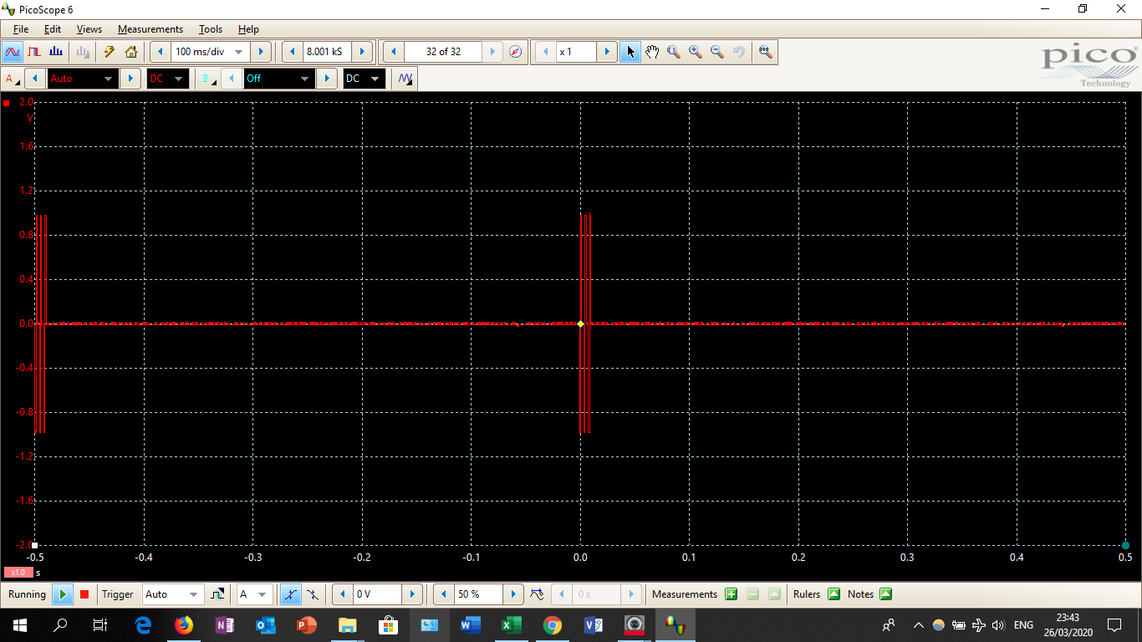
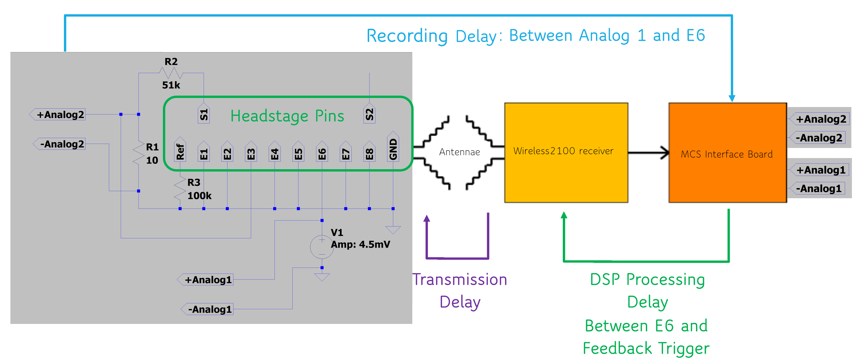
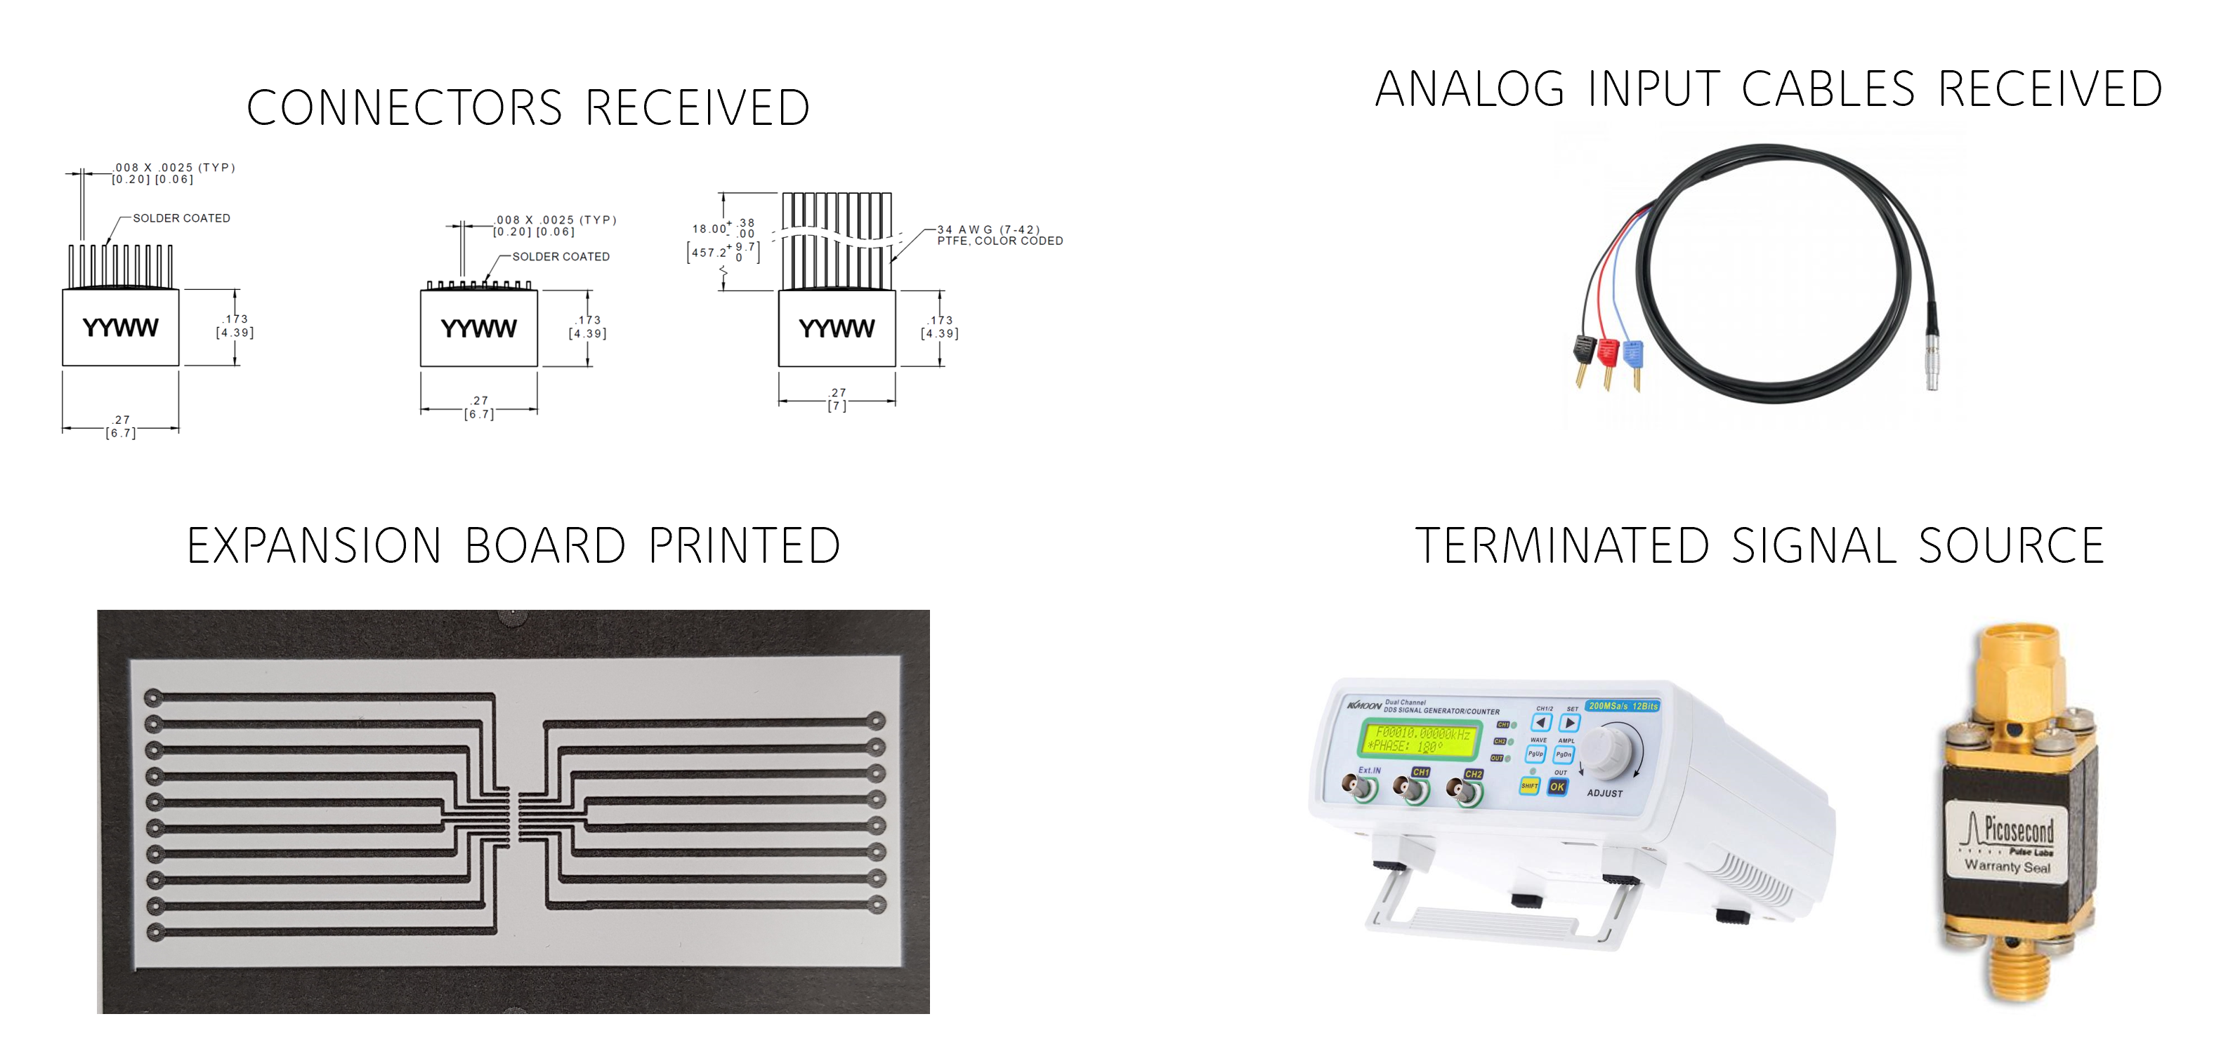

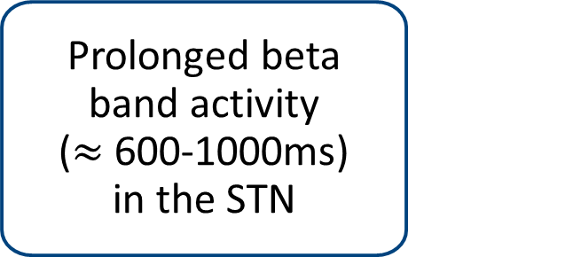
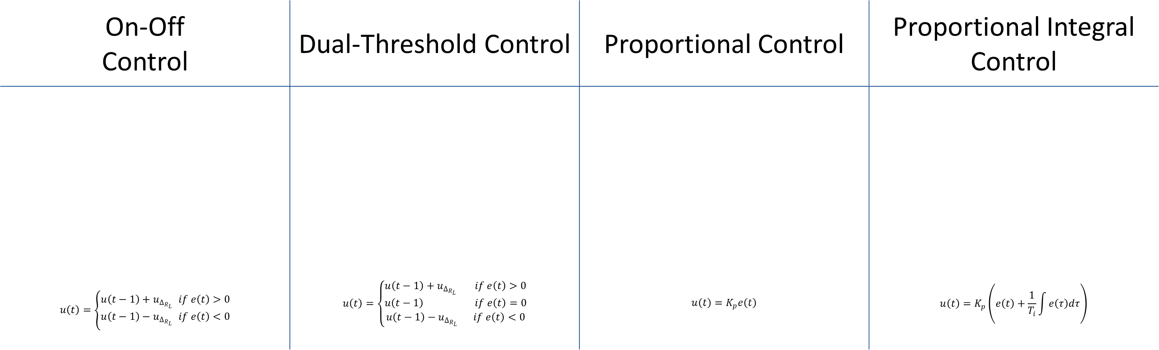
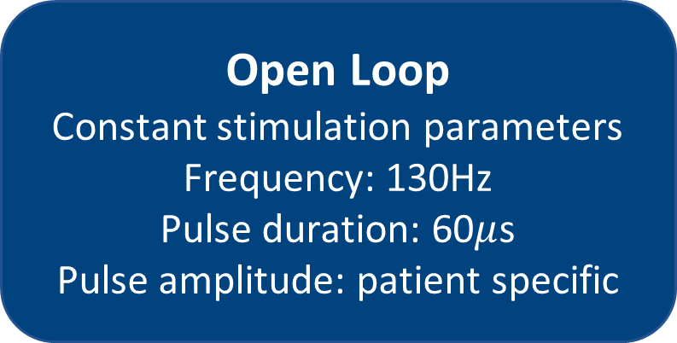
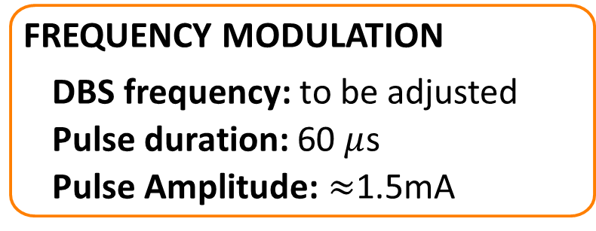
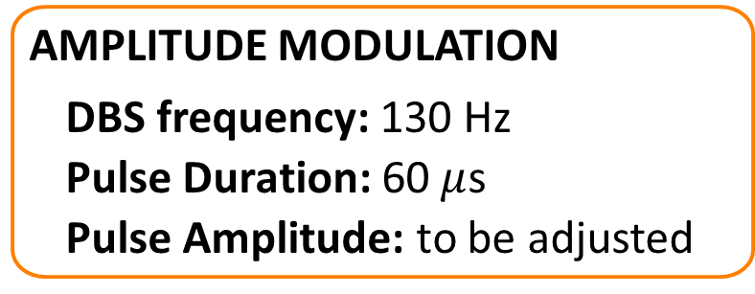
Design of a closed-loop deep brain stimulation system for pre-clinical testing in animal models
Adil Dahlan (SN: 16203187)
BE Biomedical Engineering
adil.dahlan@ucdconnect.ie
Supervisor
Prof Madeleine Lowery
I - Introduction
II - Methods
III - Results & Discussion
1. What Is Parkinson's Disease?
5. Amplitude Modulation Algorithms
10. Threshold Triggered Stimulation
On-Off Control | Dual-Threshold Control | Proportional Control | Proportional Integral Control
$$u\left(t\right)=\left\{\begin{matrix}u\left(t−1\right)+u_{Δ_{R_{L} } } if e\left(t\right)>0 \\ u\left(t−1\right)−u_{Δ_{R_{L} } } if e\left(t\right)<0\end{matrix}\right.$$ | $$u\left(t\right)=\left\{\begin{matrix}u\left(t−1\right)+u_{Δ_{R_{L} } } if e\left(t\right)>0 \\ u\left(t−1\right) if e\left(t\right)=0 \\ u\left(t−1\right)−u_{Δ_{R_{L} } } if e\left(t\right)<0\end{matrix}\right.$$ | $$u\left(t\right)=K_{p}e\left(t\right)$$ | $$u\left(t\right)=K_{p}\left(e\left(t\right)+\frac{1}{T_{i}}\int{e\left(τ\right)dτ}\right)$$
Beta ARV (μV)
e(t)
Beta ARV (μV)
e(t)
Beta ARV (μV)
e(t)
e(t)
Beta ARV (μV)
Time (s)
Time (s)
Time (s)
Time (s)
2. DBS
Recording Delay: 1ms
Processing Delay: 0ms
Stim Delay: 19ms
Frequency Modulation
11. DSP Triggered Stimulation
6. Wireless 2100 System
7. System In Operation
Access DSP
3. Traditional DBS
Closed-Loop Control
Segment Memory
-Doesn’t optimize stimulation parameters based on patient’s state or symptoms
-Uses one-fit all stimulation parameter
-Believed to attenuate aberrant neural activity
-High power consumption
Proportional Integral Control Algorithm Implementation
Open Loop
Constant stimulation parameters
Frequency: 130Hz
Pulse duration: 60$μ$s
Pulse amplitude: patient specific
Wireless System
Test System Performance
Continuous
Stimulation applied 24/7 at high frequencies (>100Hz)
Short Delays
Quantify Delays
8. Stimulation Control Options
9. Experimental Setup
IV - Acknowledgment
4. Closed-Loop Adaptive DBS
Detect ‘biomarker(s)’ to quantify symptoms
Uses complex algorithms to adjust stimulation parameters accordingly
Threshold Triggered
DSP Triggered
Prof Madeleine Lowery (Supervisor)
Threshold triggered
Single pulse pattern
Set through GUI
->Small delays
Any processing algorithm
16 pulse patterns
Set through programming DSP
DSP “calls” pulse patterns
->Intermediate delays
Limb tremor
Amplitude modulation
DBS frequency: 130 Hz
Pulse Duration: 60 $μ$s
Pulse Amplitude: to be adjusted
Mr John Fleming (PhD student)
MultiChannel Systems
Prolonged beta band activity ($≈$600-1000ms) in the STN
Frequency modulation
DBS frequency: to be adjusted
Pulse duration: 60 $μ$s
Pulse Amplitude: $≈$1.5mA

Slide 2
I - Introduction

Slide 3
1. What Is Parkinson's Disease?

Slide 4
2. DBS

Slide 5
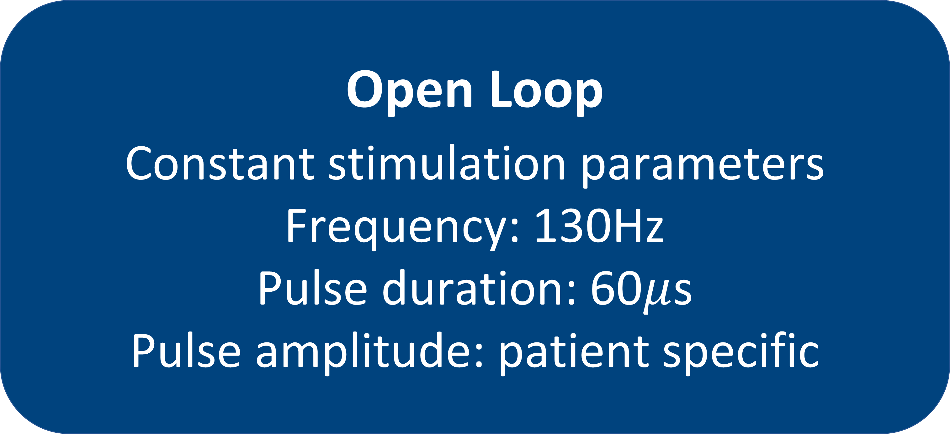
3. Traditional DBS
Open Loop
Constant stimulation parameters
Frequency: 130Hz
Pulse duration: 60$μ$s
Pulse amplitude: patient specific
-Doesn’t optimize stimulation parameters based on patient’s state or symptoms
-Uses one-fit all stimulation parameter
-Believed to attenuate aberrant neural activity
-High power consumption
Continuous
Stimulation applied 24/7 at high frequencies (>100Hz)

Slide 6
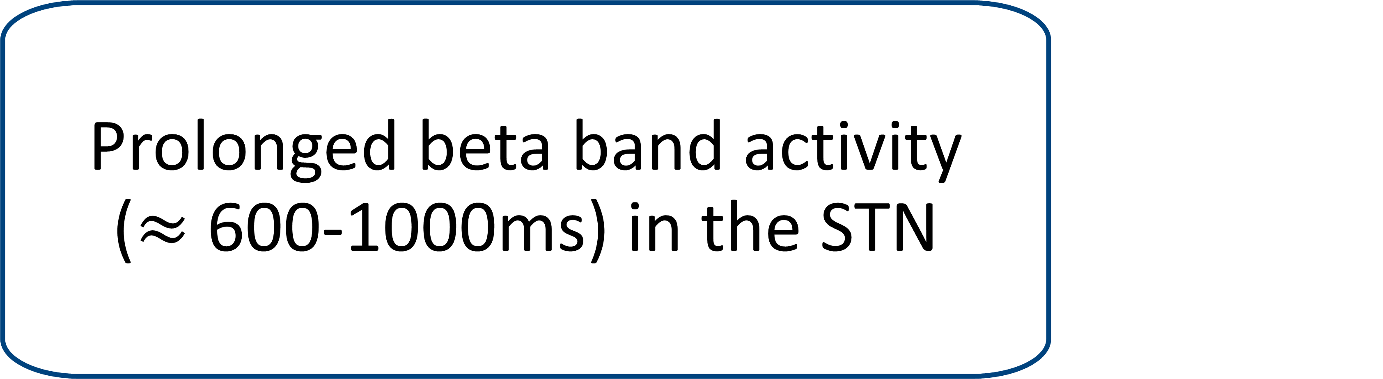
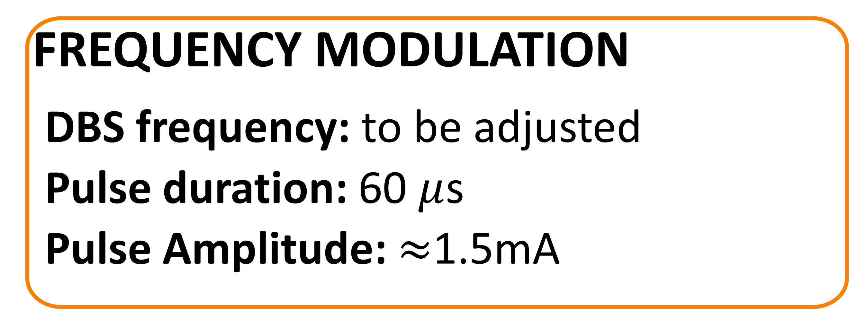
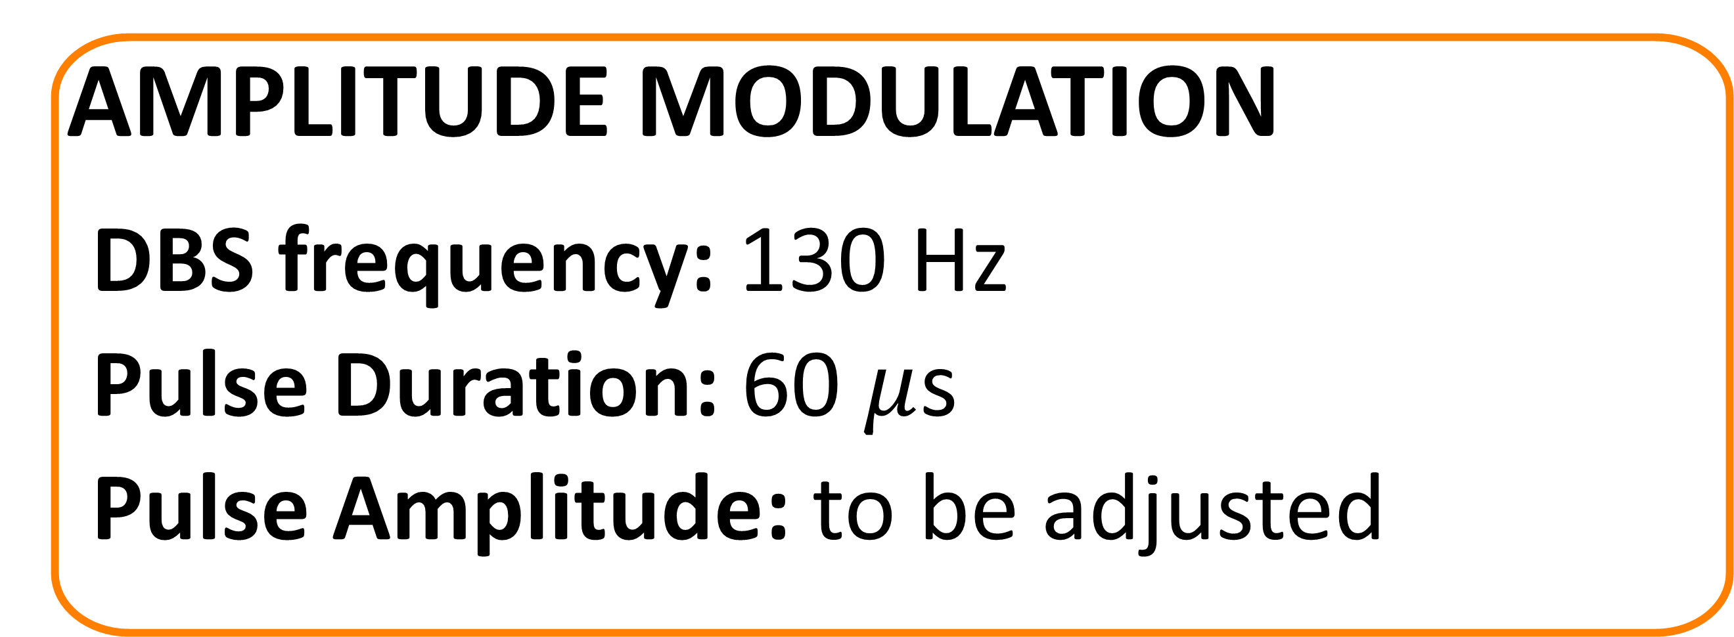
4. Closed-Loop Adaptive DBS
Detect ‘biomarker(s)’ to
quantify symptoms
Uses complex algorithms to adjust stimulation parameters accordingly
Limb tremor
Amplitude modulation
DBS frequency: 130 Hz
Pulse Duration: 60 $μ$s
Pulse Amplitude: to be adjusted
Prolonged beta band activity ($≈$600-1000ms) in the STN
Frequency modulation
DBS frequency: to be adjusted
Pulse duration: 60 $μ$s
Pulse Amplitude: $≈$1.5mA

Slide 7
II - Methods

Slide 8
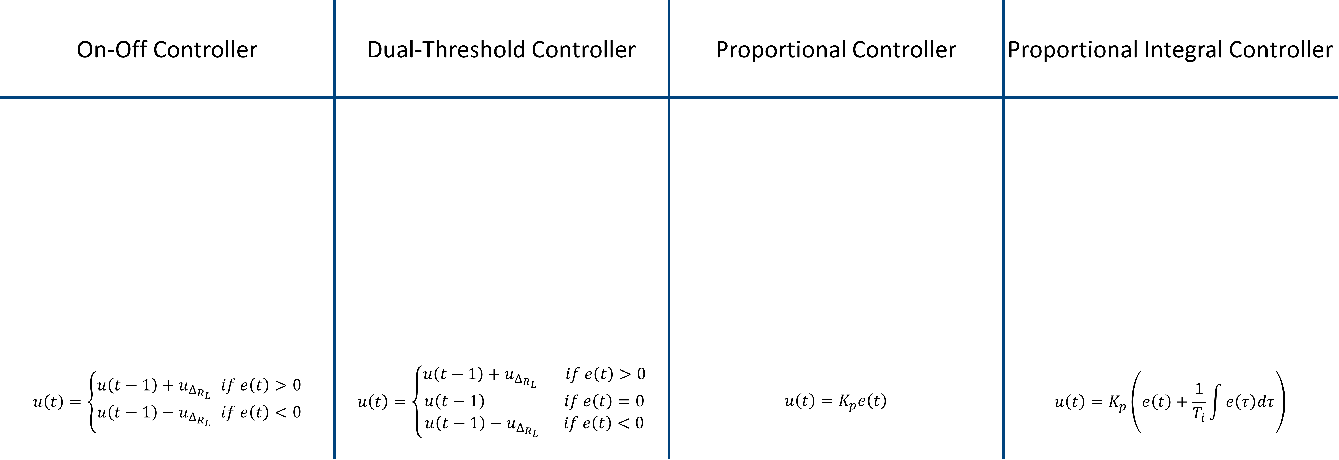
5. Amplitude Modulation Algorithms
On-Off Controller | Dual-Threshold Controller | Proportional Controller | Proportional Integral Controller
$$u\left(t\right)=\left\{\begin{matrix}u\left(t−1\right)+u_{Δ_{R_{L} } } if e\left(t\right)>0 \\ u\left(t−1\right)−u_{Δ_{R_{L} } } if e\left(t\right)<0\end{matrix}\right.$$ | $$u\left(t\right)=\left\{\begin{matrix}u\left(t−1\right)+u_{Δ_{R_{L} } } if e\left(t\right)>0 \\ u\left(t−1\right) if e\left(t\right)=0 \\ u\left(t−1\right)−u_{Δ_{R_{L} } } if e\left(t\right)<0\end{matrix}\right.$$ | $$u\left(t\right)=K_{p}e\left(t\right)$$ | $$u\left(t\right)=K_{p}\left(e\left(t\right)+\frac{1}{T_{i}}\int{e\left(τ\right)dτ}\right)$$
e(t)
e(t)
e(t)
e(t)
Beta ARV (μV)
Beta ARV (μV)
Beta ARV (μV)
Beta ARV (μV)
Time (s)
Time (s)
Time (s)
Time (s)
Frequency Modulation
Notes:
The on-off controller uses a single target and increases or decreases the stimulation if the beta ARV was measured above or below the target, respectively.
Second. The dual threshold controller which increases the stimulation if the beta ARV was measured above the upper threshold value and keeps it constant of it was in between the upper and lower thresholds and decreases it if the beta ARV was measured below the lower threshold value… this has been inspired in order to enhance healthy beta band activity
3rd, the PC which sets the the stimulation to be proportional to the difference between the beta ARV and the pre-set target
Last but not least, PIC which takes into taccount the integral of the beta band activity and has been shown
The PI control algorithm was developed by the Neuromuscular Systems Research Group under the supervision of Professor Madeleine Lowery at University College Dublin and it has been shown using computational modelling to outperform all other aDBS control algorithms. Thus, the aim of this project is to develop a DBS system to test the performance of this algorithm on animal models.
It is important to note that the PI algorithm can tolerate delays of upto around 100ms which is why the system we develop must have delays less than that, which we need to quantify

Slide 9
6. Wireless 2100 System
Closed-Loop Control
Wireless System
Short Delays

Slide 10
7. System In Operation

Slide 11
8. Stimulation Control Options
Threshold Triggered
DSP Triggered
Threshold triggered
Single pulse pattern
Set through GUI
->Small delays
Any processing algorithm
16 pulse patterns
Set through programming DSP
DSP “calls” pulse patterns
->Intermediate delays

Slide 12
9. Experimental Setup
Notes:
We applied an external signal generator of square pulses to the headstage. The headstage was programmed using the GUI to apply a predetermined pulse pattern each time the recorded signal went high
TO quantify the recording delay we also recorded the signal from the signal generator as an analog input the interface board and by coparing that with the recorded signal from the headstage we determined the recording delay
TO quantify the DSP processing delay we copared when the recorded signal from the headstage went high and when the stimulator was asked to turn on (this can be determined using the GUI)
To quantify the stimulation delay we quantified when the stimulator was asked to turn on and when the pulse pattern was obserbed at the stimulating electrode of the headstage
These delays were much less than what the PIC algorithm can tolerate as discussed later in the result section. Thus, we went on to investigat ethe DSP triggered stimulation option

Slide 13
III - Results & Discussion

Slide 14
10. Threshold Triggered Stimulation
Recording Delay: 1ms
Processing Delay: 0ms
Stimulation Delay: 19ms

Slide 15
11. DSP Triggered Stimulation
Access DSP
Segment Memory
Proportional Integral Control Algorithm Implementation
Test System Performance
Quantify Delays
Notes:
In terms of programming th DSP, we managed to adjust the stimulation pulses through writing to the registers of the DSP as shown in the following figures plotting the recorded signal from the headstage
We managed to segment the memory of the headstage into 16 dsegments each storing one pulse pattern
We managed to code the PIC algorithm into the DSp
Due to the Covid 19 situation, I wasn’t able to test the performance of the system for the DSP triggered stimulation option and quantifying the delays associated with that \. These will be done once we are allowed to access UCD campus hopefully on the 5th on May

Slide 16
IV - Acknowledgment
Prof Madeleine Lowery (Supervisor)
Mr John Fleming (PhD student)
MultiChannel Systems
Notes:
Finally, I would like to thank Prof Madeleine Lowery who supervised me throughout this project
I would like to also thank Mr John Fleming who help me a lot it programming the DSP
Last but not least, I would like to thank the MultiChannel Systems company for providing us with all the technical support we needed throughout this project.

Slide 17
Design of a closed-loop deep brain stimulation system for pre-clinical testing in animal models
Adil Dahlan (SN: 16203187)
BE Biomedical Engineering
adil.dahlan@ucdconnect.ie
Supervisor
Prof Madeleine Lowery
I - Introduction
II - Methods
III - Results & Discussion
1. What Is Parkinson's Disease?
5. Amplitude Modulation Algorithms
10. Threshold Triggered Stimulation
On-Off Control | Dual-Threshold Control | Proportional Control | Proportional Integral Control
$$u\left(t\right)=\left\{\begin{matrix}u\left(t−1\right)+u_{Δ_{R_{L} } } if e\left(t\right)>0 \\ u\left(t−1\right)−u_{Δ_{R_{L} } } if e\left(t\right)<0\end{matrix}\right.$$ | $$u\left(t\right)=\left\{\begin{matrix}u\left(t−1\right)+u_{Δ_{R_{L} } } if e\left(t\right)>0 \\ u\left(t−1\right) if e\left(t\right)=0 \\ u\left(t−1\right)−u_{Δ_{R_{L} } } if e\left(t\right)<0\end{matrix}\right.$$ | $$u\left(t\right)=K_{p}e\left(t\right)$$ | $$u\left(t\right)=K_{p}\left(e\left(t\right)+\frac{1}{T_{i}}\int{e\left(τ\right)dτ}\right)$$
Beta ARV (μV)
e(t)
Beta ARV (μV)
e(t)
Beta ARV (μV)
e(t)
e(t)
Beta ARV (μV)
Time (s)
Time (s)
Time (s)
Time (s)
2. DBS
Recording Delay: 1ms
Processing Delay: 0ms
Stim Delay: 19ms
Frequency Modulation
11. DSP Triggered Stimulation
6. Wireless 2100 System
7. System In Operation
Access DSP
3. Traditional DBS
Closed-Loop Control
Segment Memory
-Doesn’t optimize stimulation parameters based on patient’s state or symptoms
-Uses one-fit all stimulation parameter
-Believed to attenuate aberrant neural activity
-High power consumption
Proportional Integral Control Algorithm Implementation
Open Loop
Constant stimulation parameters
Frequency: 130Hz
Pulse duration: 60$μ$s
Pulse amplitude: patient specific
Wireless System
Test System Performance
Continuous
Stimulation applied 24/7 at high frequencies (>100Hz)
Short Delays
Quantify Delays
8. Stimulation Control Options
9. Experimental Setup
IV - Acknowledgment
4. Closed-Loop Adaptive DBS
Detect ‘biomarker(s)’ to quantify symptoms
Uses complex algorithms to adjust stimulation parameters accordingly
Threshold Triggered
DSP Triggered
Prof Madeleine Lowery (Supervisor)
Threshold triggered
Single pulse pattern
Set through GUI
->Small delays
Any processing algorithm
16 pulse patterns
Set through programming DSP
DSP “calls” pulse patterns
->Intermediate delays
Limb tremor
Amplitude modulation
DBS frequency: 130 Hz
Pulse Duration: 60 $μ$s
Pulse Amplitude: to be adjusted
Mr John Fleming (PhD student)
MultiChannel Systems
Prolonged beta band activity ($≈$600-1000ms) in the STN
Frequency modulation
DBS frequency: to be adjusted
Pulse duration: 60 $μ$s
Pulse Amplitude: $≈$1.5mA

